Slide 1

VIRTUAL PRIVATE NETWORKS (VPN)
Group of 2c10 class
Nguyen Van Cong
Tran Phi Hung
Dang Thi Duyen
Nguyen Trung Kien
Lai Thi Mai

Slide 2

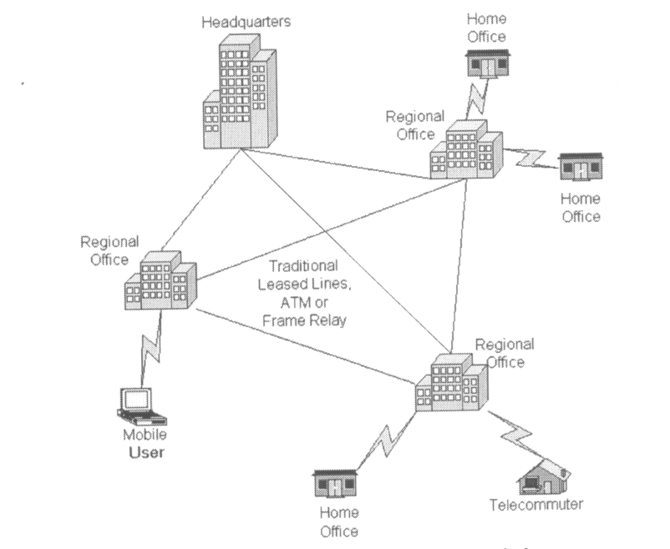
Traditional connectivity

Slide 3
VIRTUAL PRIVATE NETWORKS
1. The definition
2. Why have VPN
3. VPN network protocols
4. Advantages and Disadvantages
5. VPN application ( openVPN )

Slide 4
Definition
The VPN ( Virtual Private Networks) is the secure connection between two or more endpoints. It can also be seen as an extension to a private network.
The are 2 key types of VPN Scenarios :
- Site to site VPN
- Remote access VPN

Slide 5
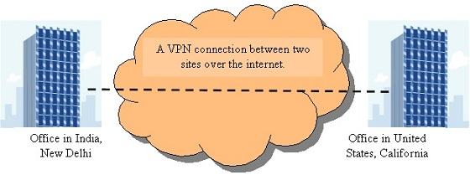
Site to site VPN
Data is encrypted from one VPN gateway to the other, providing a secure link between two sites over the internet.
This would enable both sites to share resources over the VPN link.

Slide 6
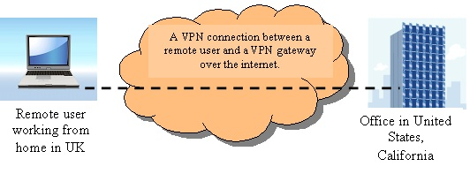
Remote access VPN
VPN scenario would be made from an individual computer to a VPN gateway.
This would enable a user to access their e-mail, files and other resources at work from where ever they may be, providing they have an internet connection.

Slide 7
Why have VPN
saving cost on resources (e-mail servers, file servers, etc )
providing a superb solution for companies with several branch offices
providing all data packets with high level of security.

Slide 8
VPN Networking protocols
PPTP -- Point-to-Point Tunneling Protocol
L2TP -- Layer 2 Tunneling Protocol
IPsec -- Internet Protocol Security
SSL VPN (Secure Socket Layer)

Slide 9
PPTP -- Point-to-Point Tunneling Protocol
Being a protocol or technology supports the use of VPN’s.
Helping remote users dialing into their local internet security providers to connect securely to their networks via the internet.
Being considered as a weak security protocol according to many experts.

Slide 10
L2TP -- Layer 2 Tunneling Protocol
Being an extension of the PPTP (Point to point tunneling protocol)
used by internet service providers to provide VPN services over the internet.
L2TP combines the functionality of PPTP and L2F
with some additional functions using some of the
IPSec functionality.
L2TP can be used in conjunction with IPSec to provide encryption, authentication and integrity.

Slide 11
IPsec -- Internet Protocol Security
Operating on layer 3 and can protecting any protocol that runs on top of IP.
Being a framework consisting of various protocols and algorithms which can be added to and developed.
Providing flexibility and strength in depth, being almost perfect solution for securing VPN’s.
setting up on the corporate network and on the client end. IPSec is used for both site to site and remote user connectivity.

Slide 12
SSL VPN (Secure Socket Layer)
Providing excellent security for remote access users as well as ease of use.
there is no client software if a user was using the SSL portal to access applications on the network .
SSL can also imitate the way IPSec works via a lightweight software
thousands of end user’s would be able to access the corporate network without the support of an administrator and possible hours of configuring and trouble shooting, unlike IPSec. The end user would just need to know the address of the SSL VPN portal

Slide 13
Advantages and disadvantages

Slide 14
Advantages
Cost Savings
Eliminating the need for expensive long-distance leased lines
Reducing the long-distance telephone charges for remote access.
Transferring the support burden to the service providers
Operational costs

Slide 15
Scalability
Flexibility of growth
Efficiency with broadband technology

Slide 16
Disadvantages
VPNs require an in-depth understanding of public network security issues and proper deployment of precautions
Availability and performance depends on factors largely outside of their control
Immature standards
VPNs need to accommodate protocols other than IP and existing internal network technology

Slide 17

APPLICATIONS

Slide 18
Definition
OpenVPN is a full-featured virtual private network (VPN) solution which can accomodate a wide range of configurations, including remote access, site-to-site VPNs, WiFi security, and enterprise-scale remote access solutions with load balancing, failover, and fine-grained access-controls.

Slide 19
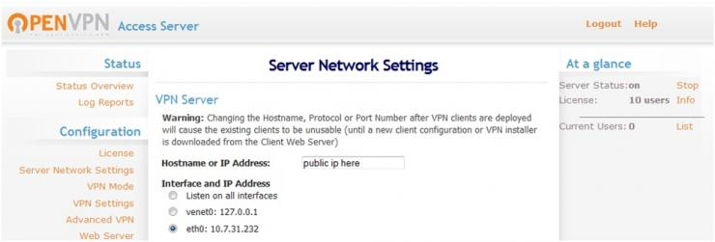
Setting the sever network

Slide 20
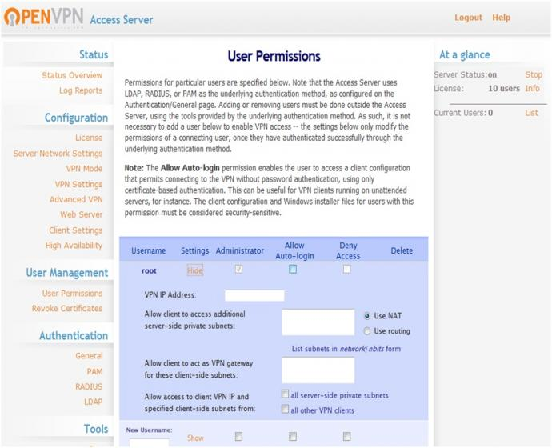
User Permissions

Slide 21
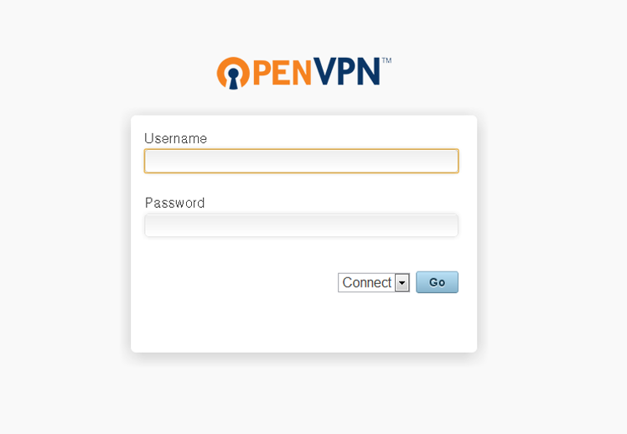
Connect clients

Slide 22


Slide 23


Q & A

